Slide 1
Vertical Farming
The future of food security!!

Slide 2
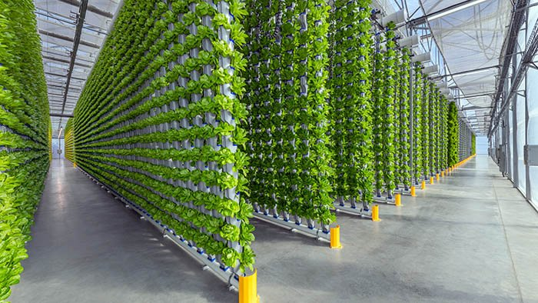
What is Vertical Farming ?
Crops are grown in vertical or stacked layers
Based on Controlled Environment Agriculture (CEA)
Physical properties like temperature, pressure, humidity, light etc., can be controlled manually
First proposed by Dr. Dickson Despommier.

Slide 3
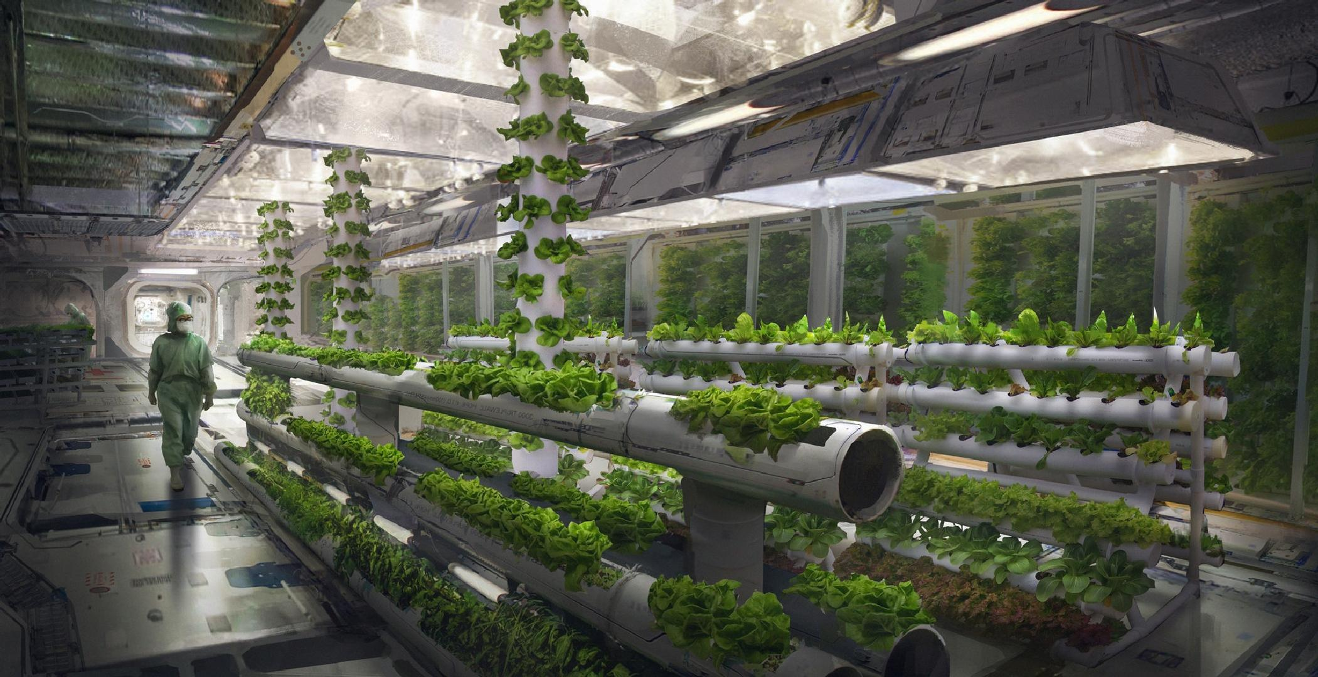
Techniques used - Hydroponics
Growing plants without soil and using liquid solutions
Both macro and micronutrients are introduced manually into the solution.

Slide 4
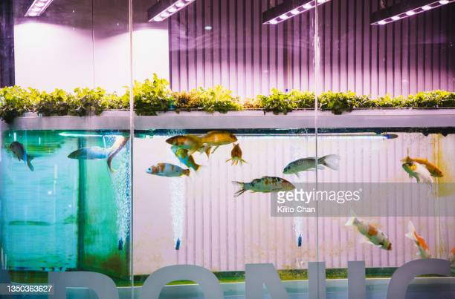
Aquaponics
In Aquaponics, plants and fish are grown together.
The water used by the fish is fed into the bio filter system which contains bacteria that can break ammonia into nitrates for the plants.
The plants further filter the water and make it clean
Plants also absorb the CO2 exhaled by the fish.
The cycle continues.

Slide 5
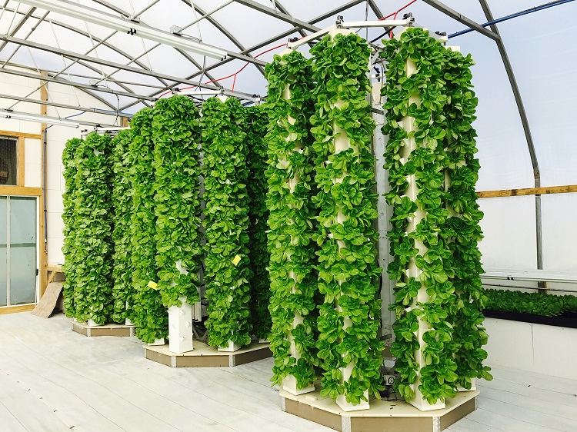
Aeroponics
No water or soil is used
The nutrients are provided in the form of mist
The plants gets suspended in the gas chambers

